Slide 1
Single Shot detector WITH MOBILENET
Purva Chiniya
IIT Roorkee
Motto:Striving to win

Slide 2
Dataset :
Pascal VOC 2007 and Pascal VOC 2012 for training
PASCAL VOC 2007 trainval for validation
PASCAL VOC Test 2007 for evaluation
Model and Weights:
Training is done using VGG16 model as in the paper
ILSVRC weights has been used as in the original model.

Slide 3
Paper : SSD
Single Shot: this means that the tasks of object localization and classification are done in a single forward pass of the network
MultiBox: this is the name of a technique for bounding box regression developed by Szegedy et al.
Detector: The network is an object detector that also classifies those detected objects

Slide 4
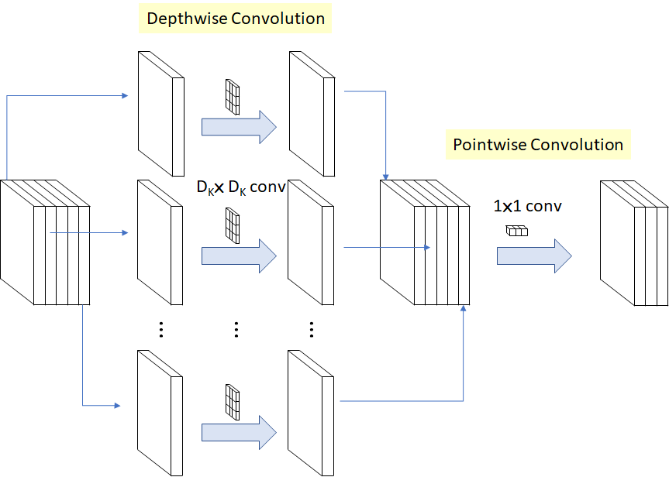
Mobile net Architecture:
1. Depth wise Separable Convolution
Depth wise separable convolution is a depth wise convolution followed by a pointwise convolution as follows:

Slide 5
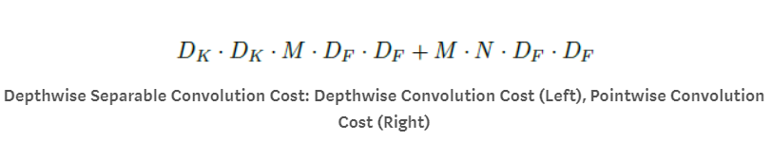
Depthwise convolution is the channel-wise DK×DK spatial convolution. Suppose in the figure above, we have 5 channels, then we will have 5 DK×DK spatial convolution.
Pointwise convolution actually is the 1×1 convolution to change the dimension.
With above operation, the operation cost is:
where M: Number of input channels, N: Number of output channels, DK: Kernel size, and DF: Feature map size.

Slide 6

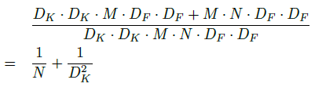
For standard convolution, it is:
Thus, the computation reduction is:

Slide 7
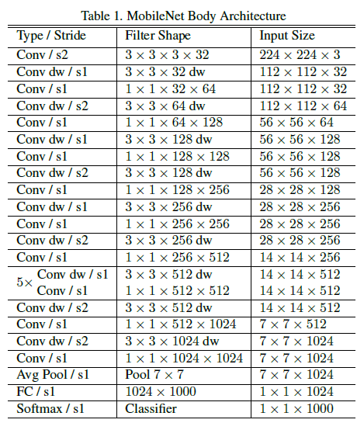
MOBILENET ARCHITECTURE

Slide 8
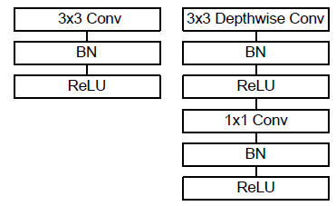
Batch Normalization (BN) and ReLU are applied after each convolution

Slide 9
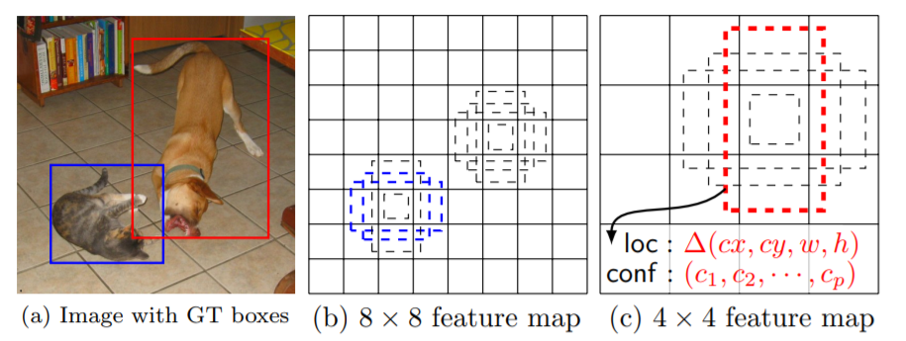
Every feature map cell is associated with a set of default bounding boxes of different dimensions and aspect ratios. These priors are manually (but carefully) chosen, whereas in MultiBox, they were chosen because their IoU with respect to the ground truth was over 0.5. This in theory should allow SSD to generalise for any type of input, without requiring a pre-training phase for prior generation. For instance, assuming we have configured 2 diagonally opposed points (x1, y1) and (x2, y2) for each b default bounding boxes per feature map cell , and c classes to classify, on a given feature map of size f = m * n, SSD would compute f * b * (4 + c) values for this feature map.

Slide 10
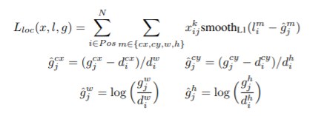
Location Loss:
SSD uses smooth L1-Norm to calculate the location loss. While not as precise as L2-Norm, it is still highly effective and gives SSD more room for manoeuvre as it does not try to be “pixel perfect” in its bounding box prediction (i.e. a difference of a few pixels would hardly be noticeable for many of us).

Slide 11
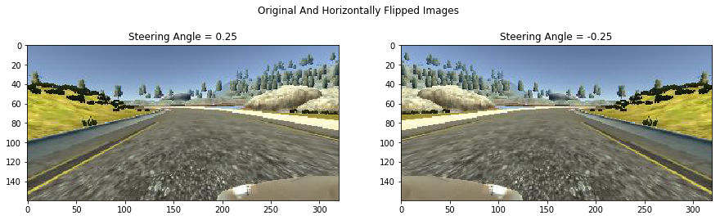
Data Augmentation
The authors of SSD stated that data augmentation, like in many other deep learning applications, has been crucial to teach the network to become more robust to various object sizes in the input. To this end, they generated additional training examples with patches of the original image at different IoU ratios (e.g. 0.1, 0.3, 0.5, etc.) and random patches as well. Moreover, each image is also randomly horizontally flipped with a probability of 0.5, thereby making sure potential objects appear on left and right with similar likelihood.

Slide 12
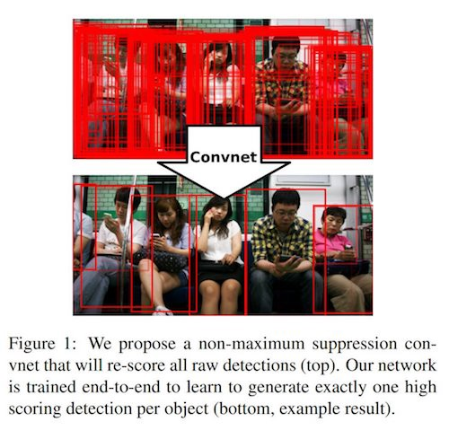
Non-Maximum Suppression (NMS)
Given the large number of boxes generated during a forward pass of SSD at inference time , it is essential to prune most of the bounding box by applying a technique known as non-maximum suppression: boxes with a confidence loss threshold less than ct (e.g. 0.01) and IoU less than lt (e.g. 0.45) are discarded, and only the top N predictions are kept. This ensures only the most likely predictions are retained by the network, while the more noisier ones are removed

Slide 13
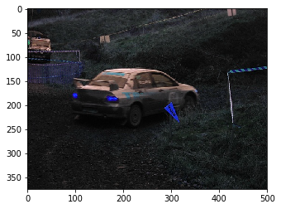
Input Image:

Slide 14
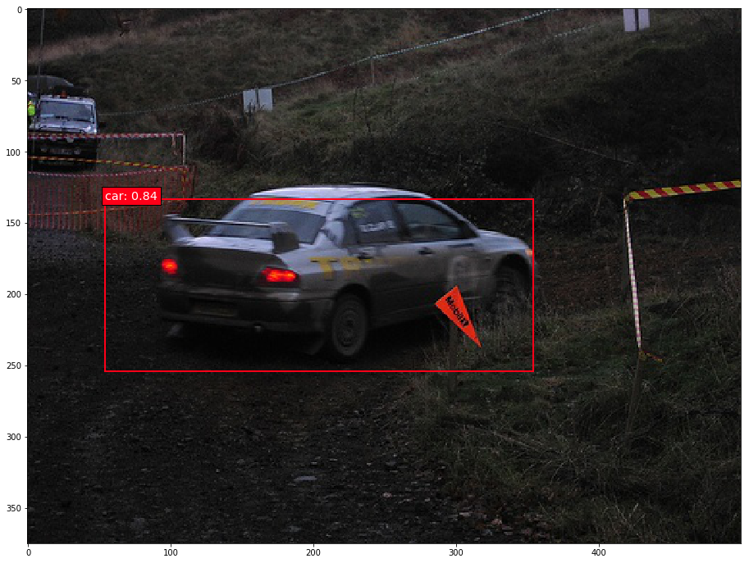
Output of the model:

Slide 15
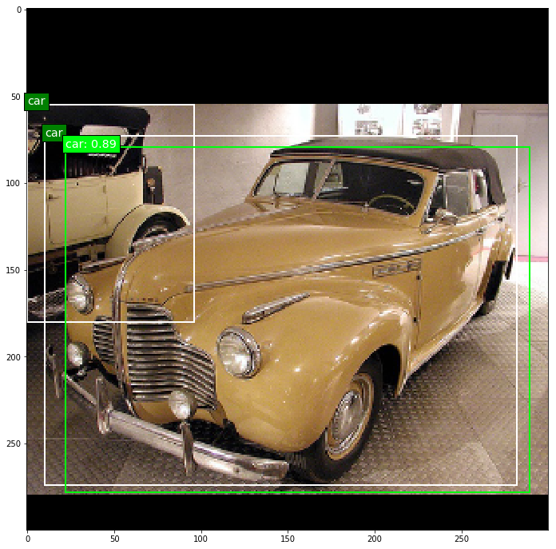
#Training Output

Slide 16
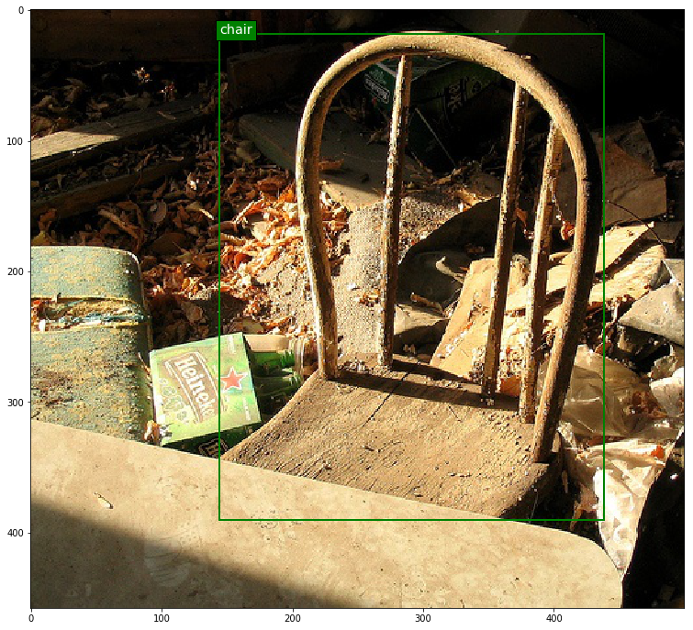

Slide 17
Predictions:
Output on voc test dataset is stored in repo.

